Slide 1

Securing Network with OpenSSL
By
Keshav Sharma and Shane Chan

Slide 2
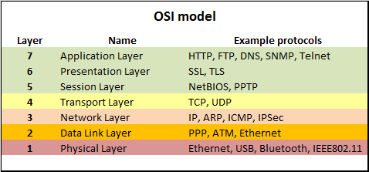
What is SSL
SSL stands for Secure Socket Layer
Network Protocol which runs on in between presentation layer and Transport layer
Now SSL has successor which is called TLS stands for Transport Layer Security
Figure1. OSI Layers and Protocols used

Slide 3
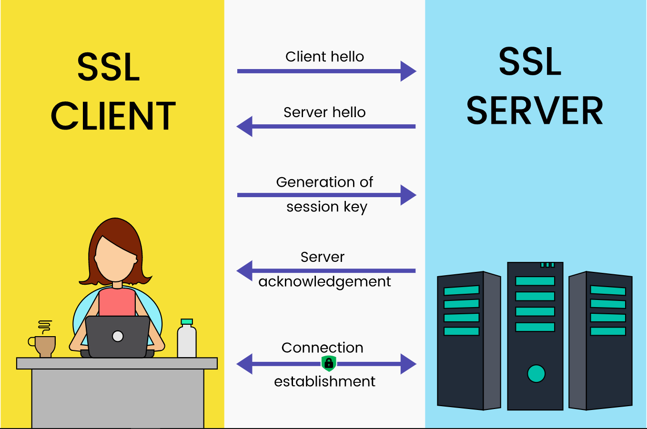
Why We need SSL/TLS
SSL/TLS is used for securing connection between systems so that they can share important information and no one other can read or modify it.
SSL/TLS basically use encryption algorithms to encrypt that data and share keys only to system who are communicating with each other
Figure 2. SSL Client-Server communication

Slide 4
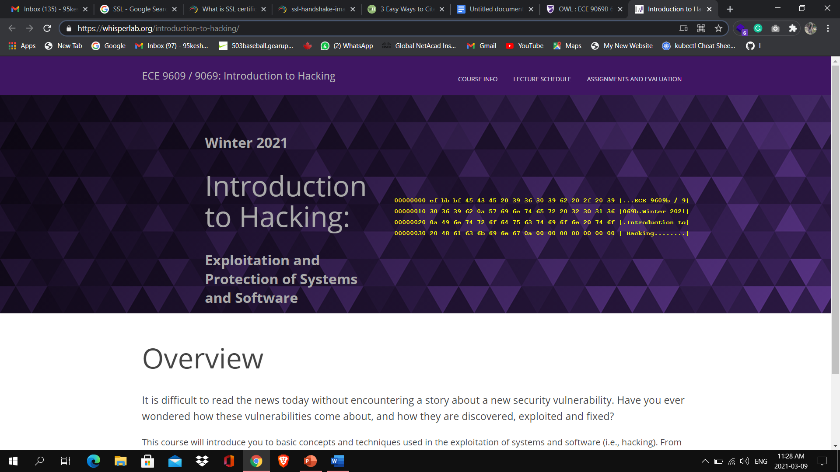
Always check for SSL Connection
Do Following Steps
See URL of website , it should have https written in front of it
HTTPS stands from Hyper Text Protocol Secure
If it is there it means connection is secured by SSL/TLS

Slide 5
How To Get SSL Certificate?
Its Easy, as there are many companies which sell SSL encryption certificate service.

Slide 6



Various Open-Source SSL certificate Service
All these come under open-source license.
Can be commercially used for free
No hidden charges

Slide 7
What is OpenSSL
It is open-source cryptographic library.
Written in C, Assembly and Perl
It is used for data encryption
It has various encryption algorithm and provide many encryption tools
SSL/TLS is one of encryption tool provided by OpenSSL

Slide 8

History Of OpenSSL
Released on 23 December 1998 by OpenSSL Project Team
Left to right: Paul Dale, Kurt Roeckx, Richard Levitte, Matt Caswell, Mark Cox, Tim Hudson
In 2019 OpenSSL is managed by OpenSSL management committee
This project budget is around one million per year which primarily completed by donations

Slide 9
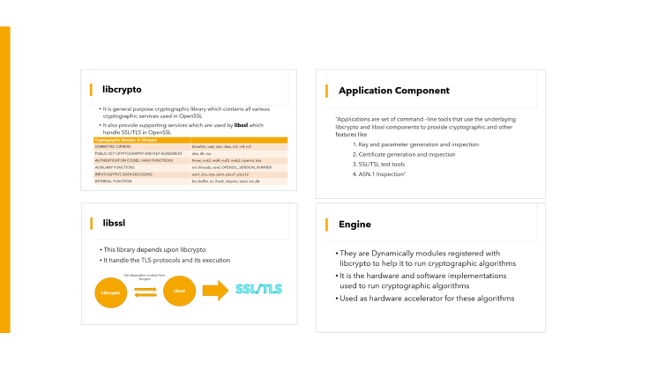

How OpenSSL is Work
Open SSL architecture is divided into 4 parts

Slide 10
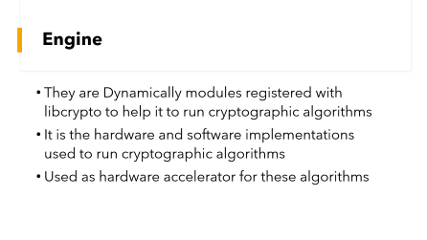
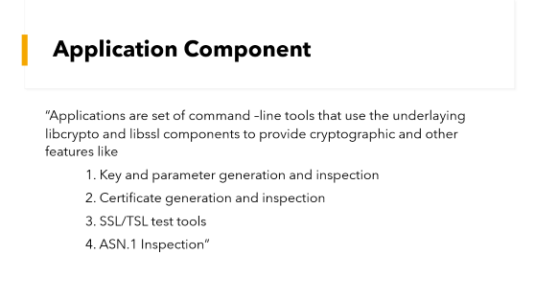
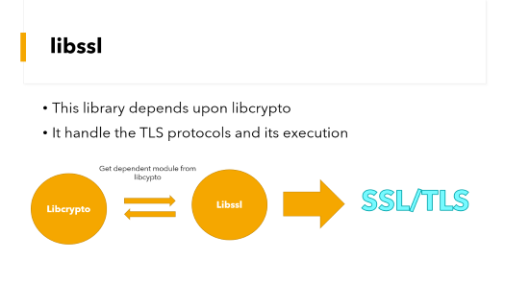
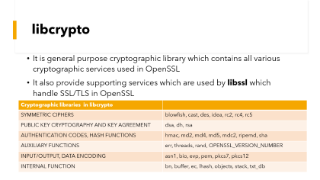
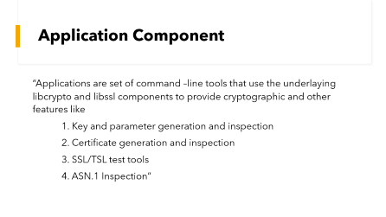


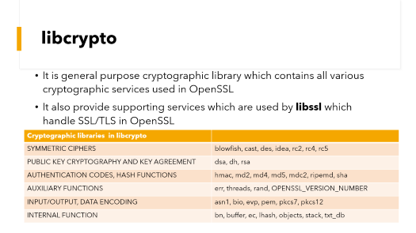

Slide 11
libcrypto
It is general purpose cryptographic library which contains all various cryptographic services used in OpenSSL
It also provide supporting services which are used by libssl which handle SSL/TLS in OpenSSL
Cryptographic libraries in libcrypto
SYMMETRIC CIPHERS | blowfish, cast, des, idea, rc2, rc4, rc5
PUBLIC KEY CRYPTOGRAPHY AND KEY AGREEMENT | dsa, dh, rsa
AUTHENTICATION CODES, HASH FUNCTIONS | hmac, md2, md4, md5, mdc2, ripemd, sha
AUXILIARY FUNCTIONS | err, threads, rand, OPENSSL_VERSION_NUMBER
INPUT/OUTPUT, DATA ENCODING | asn1, bio, evp, pem, pkcs7, pkcs12
INTERNAL FUNCTION | bn, buffer, ec, lhash, objects, stack, txt_db

Slide 12
libssl
This library depends upon libcrypto
It handle the TLS protocols and its execution
Get dependent module from libcypto
Libcrypto
Libssl
SSL/TLS

Slide 13
Engine
They are Dynamically modules registered with libcrypto to help it to run cryptographic algorithms
It is the hardware and software implementations used to run cryptographic algorithms
Used as hardware accelerator for these algorithms

Slide 14
Application Component
“Applications are set of command –line tools that use the underlaying libcrypto and libssl components to provide cryptographic and other features like
1. Key and parameter generation and inspection
2. Certificate generation and inspection
3. SSL/TSL test tools
4. ASN.1 Inspection”

Slide 15
User Space
Applications
OpenSSl Library (libssl)
Kernel Space
Engine
Lib Crypto
Software Algorithm
Hardware Accelerator Driver
Hardware
Hardware Accelerator Engine

Slide 16
Merits and Demerits of OpenSSL
Merits
It is open-source and free of charge.
It has wide functionality, supports many protocols and algorithms.
It is written in C, has Multi-platform adaptation.
Demerits
Insufficient documentation adds difficulty for using.
The quality of code in parts of the library is not good(easy to be hacked).

Slide 17
Thank You！

